Slide 1

Airline Reservation System (ARS)

Slide 2

BATCH CODE: PR2-202205B+05B1+06B
Sir Anas Abdul Sammad
GROUP MEMBERS
Mirza Haseeb Baig (Student1381068)
Muhammad Huzaifa Farooq (Student1384167)
Alishba Khan (Student1369581)
Syed abdul dayyan (Student1395205)

Slide 3
Table of Contents
Problem Definition
Customer Requirement Specification
Project Plan
E-R Diagrams
Algorithms
GUI Standards Document
Interface Design Document
Task Sheet
Project Review and Monitoring Report
Unit Testing Check List
Final Check List

Slide 4
Hardware/ Software Requirements
Hardware
A minimum computer system that will help you access all the tools in the
courses is a Pentium 166 or better
128 Megabytes of RAM or better
Software
Visual Studio .Net / ASP
IIS server
.Net Framework
Java Virtual Machine/ J2EE server
Notepad/Java editor
j2sdk1.4.1_02 (or later).
EJB Dev Kit
Java enabled web server
JSP / Servlets Dev. Kit

Slide 5
ACKNOWLEDGMENT
1. Introduction.
2. Objectives.
3. Problem Statement.
4. Hardware/ Software Requirements.
5. Screenshots of output.
6. Screenshots of code.

Slide 6
INTRODUCTION
The industry today demands IT professionals who are eager to learn, upgrade their technical skills, and apply concepts quickly in real-life situations. However, busy work schedules, distant locations, and inconvenient time slots often make it difficult to put these concepts into practice. This is why finding alternative ways to implement learning through a step-by-step approach is crucial.
These challenges also affect our students. Their busy schedules make it hard to keep up with the constant need for integrated applications, especially in IT education where technology evolves rapidly. Fortunately, technology itself can help us overcome these obstacles.
With this in mind, and in line with our commitment to incorporating technology in our training, we at Aptech have developed a revolutionary way for our students to learn and apply concepts. We offer a live and synchronous eProject learning environment, enabling students to use the tools themselves and experience hands-on learning.

Slide 7
OBJECTIVES OF THE PROJECT
The objective of this program is to provide you with a sample project to work on real-life applications, helping you build more complex and robust solutions.
Rather than teaching the software itself, the goal is to present you with a real-life scenario and guide you in creating basic applications using the tools provided.
You can review the topics before starting the project.
These projects should be completed during lab sessions with faculty assistance if needed.
It is crucial for students to have a clear understanding of the subject.
If you have any questions about the application or its objectives, please contact the eProjects Team.

Slide 8
Problem Definition
.
The Airline Reservation System (ARS) is designed to assist an airline with various transactions related to ticket reservations. These transactions include blocking, reserving, canceling, and rescheduling tickets.

Slide 9
Customer Requirement Specification
From the viewpoint of the airlines:
Minimize repetitive work: Reduce the repetitive tasks performed by system administrators and reservation clerks.
Consistent process: Ensure that users follow the same steps in the system as they would in traditional desk-reservation systems.
Maintain customer information: Store customer data for emergencies, such as flight cancellations, and for tracking user preferences and travel patterns to improve service, plan routes, and optimize marketing and scheduling.
Maximize revenue:
Increase awareness among frequent travelers about special offers and discounts.
Minimize vacant seats on flights to maximize capacity utilization.
Implement a flexible pricing policy with dynamically determined ticket prices based on booking timing.

Slide 10
Customer Requirement Specification
From the viewpoint of the users:
Reduce effort and frustration: Simplify the process of scheduling a trip and reduce the effort required to find the necessary flight.
Show all possible combinations: Display all possible flight combinations and itineraries for origin-destination city pairs.
Reduce redundancy: Minimize redundant information required from customers when purchasing tickets or creating user accounts.
Validate input data: Check the validity of input data and provide feedback on errors or inconsistencies.
Easy access: Enable travelers to easily check ticket status or make changes to their trip.

Slide 11
System Context
The ARS will provide the following easy-to-use, interactive, and intuitive interfaces:
Desktop GUI: An intuitive Graphical User Interface for clerks and administrators.
Web GUI: An interactive GUI accessible via the World Wide Web for general customers.
Functionalities: Both interfaces will allow users to check flight schedules, seat availability, ticket prices, and perform transactions such as blocking, reserving, canceling, and rescheduling tickets.

Slide 12
Proposed Solution
(1) User Accounts:
User Choices: Users can choose to log in as a guest or a registered user, affecting their ability to check availability and make reservations.
Registered User: A user with a profile in the database, allowing them to check availability and make reservations.
Guest User: A new user who can only check availability unless they register and create a profile.
(2) Registration and User Profile:
Information Required: User ID, password, first name, last name, address, phone number, email, sex, age, preferred credit card number.

Slide 13
(3) Checking Availability:
Input Details: Origin city, destination city, class, trip type (one-way or round trip), departure date, and number of passengers (adults, children, seniors).
Flight Schedule Database: Check for operational service between cities and suggest possible routes if direct service is unavailable.
Results Display: Display flight options in a tabular form, including flight number, departure and arrival times, duration, and seat availability.
Ticket Price: Display the ticket price and cancellation policies.
(4) Making Reservations/Blocking/Confirmation:
Blocking vs Buying: Users can block tickets if the departure date is more than two weeks away; otherwise, they must buy the ticket.
Update Database: Update the reservation database to reflect blocked or reserved tickets and adjust available seat counts accordingly.

Slide 14
(5) Confirm Ticket:
Blocking Number: Users must confirm blocked tickets before two weeks of departure or the tickets will be canceled.
Reservation Database: Update the database to confirm the reservation and charge the user's credit card.
(6) Reschedule Ticket:
Confirmation Number: Only confirmed tickets can be rescheduled.
New Dates: Allow users to select new travel dates and update the database accordingly.
(7) Cancellation:
Blocking Number or Confirmation Number: Required to cancel tickets.
Refund Policies: Display applicable cancellation rules and process refunds accordingly.
(8) Update Profile:
User Information: Allow users to update their profile information at any time.
(9)View Ticket Status:
Trip Details: Allow users to view trip details and any last-minute changes.
(10) Query Flight Details:
Flight Information: Provide arrival and departure times for any given flight number and date.

Slide 15
System Context
The ARS will provide the following easy-to-use, interactive, and intuitive interfaces:
Desktop GUI: An intuitive Graphical User Interface for clerks and administrators.
Web GUI: An interactive GUI accessible via the World Wide Web for general customers.
Functionalities: Both interfaces will allow users to check flight schedules, seat availability, ticket prices, and perform transactions such as blocking, reserving, canceling, and rescheduling tickets.

Slide 16
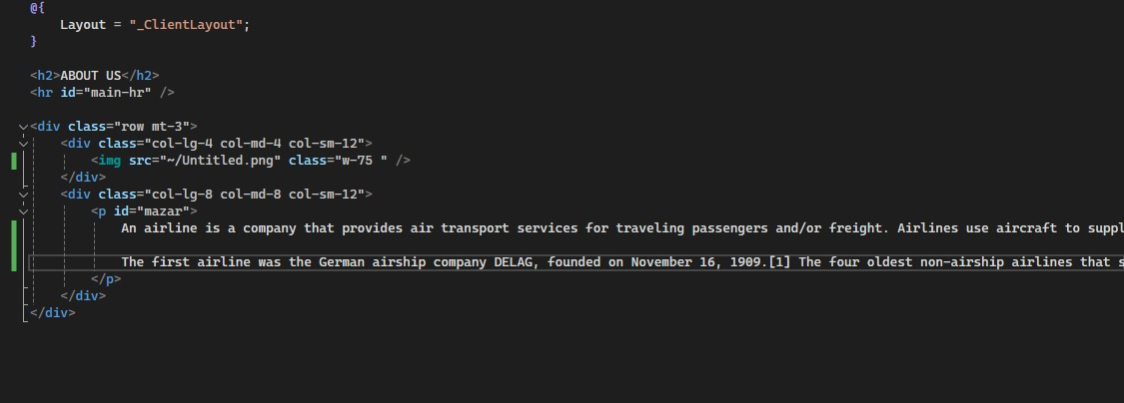
AboutUs CODE

Slide 17
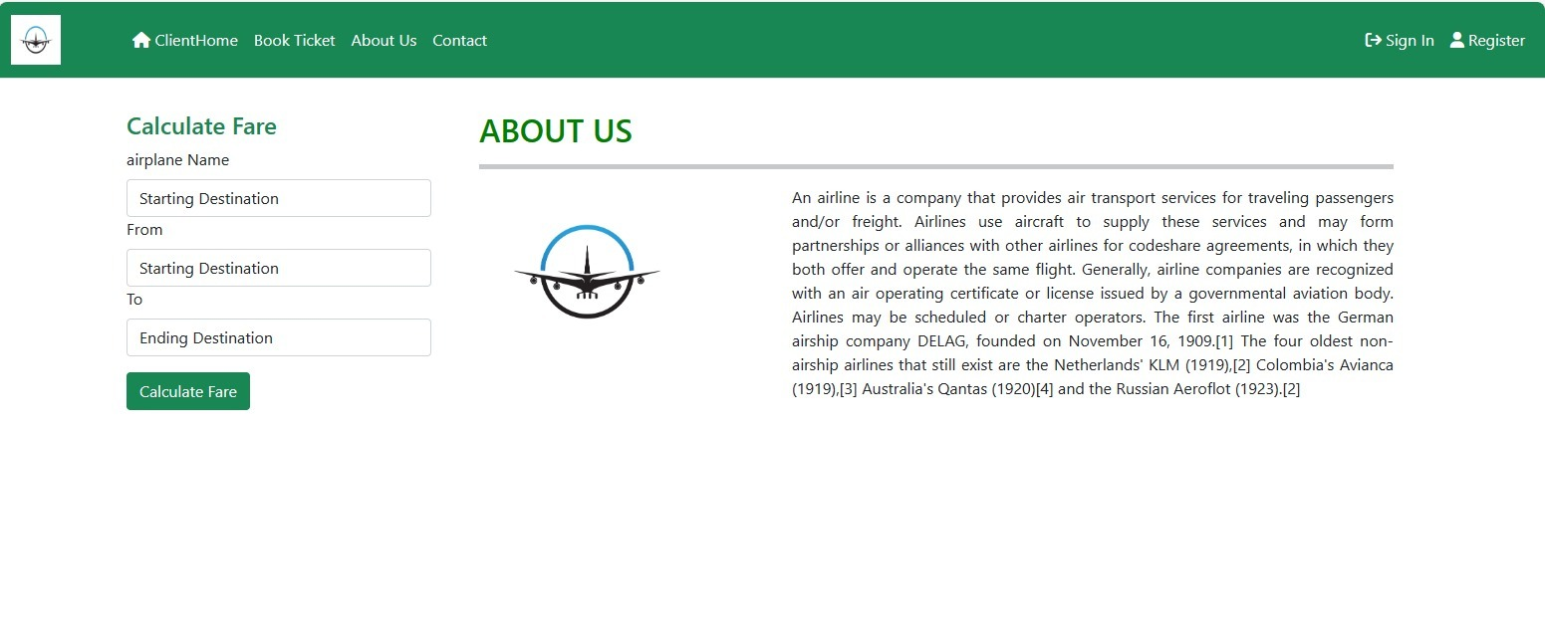
AboutUs Interface

Slide 18
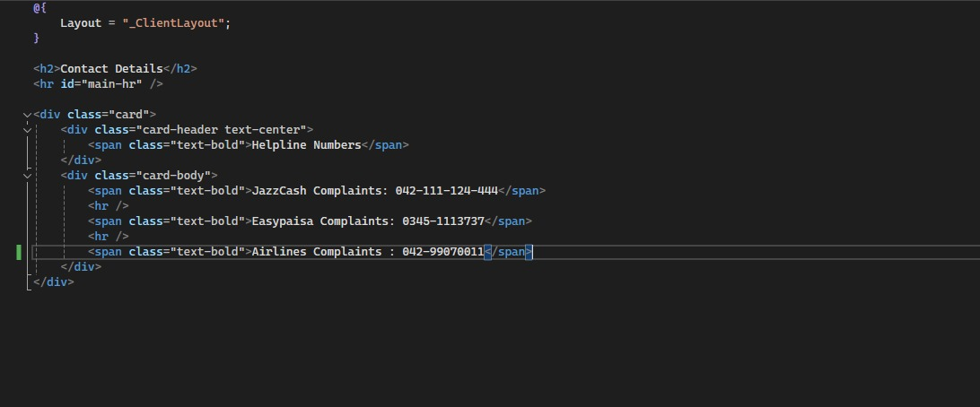
Contact CODE

Slide 19
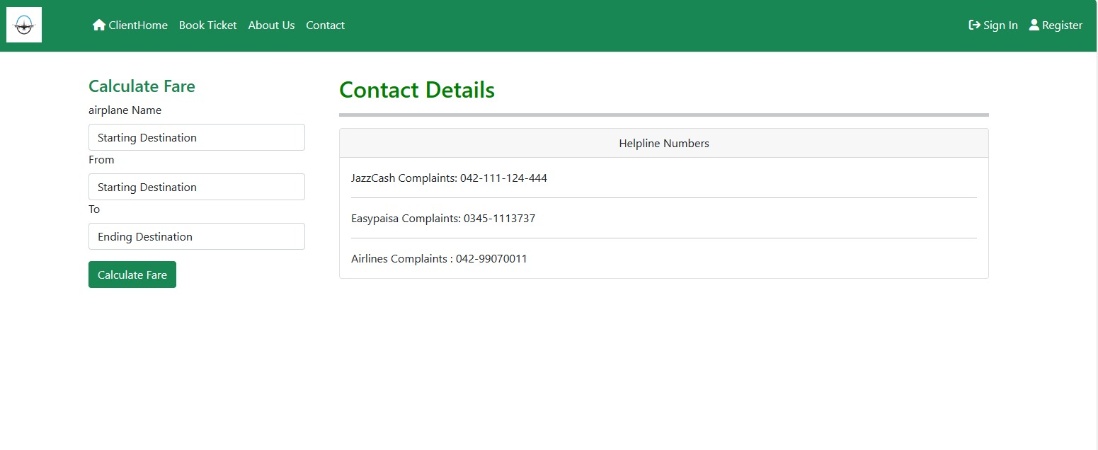
Contact Interface

Slide 20
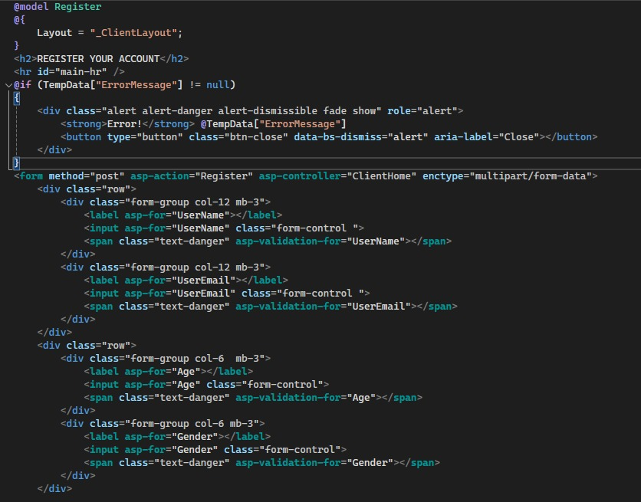
Register page Code

Slide 22
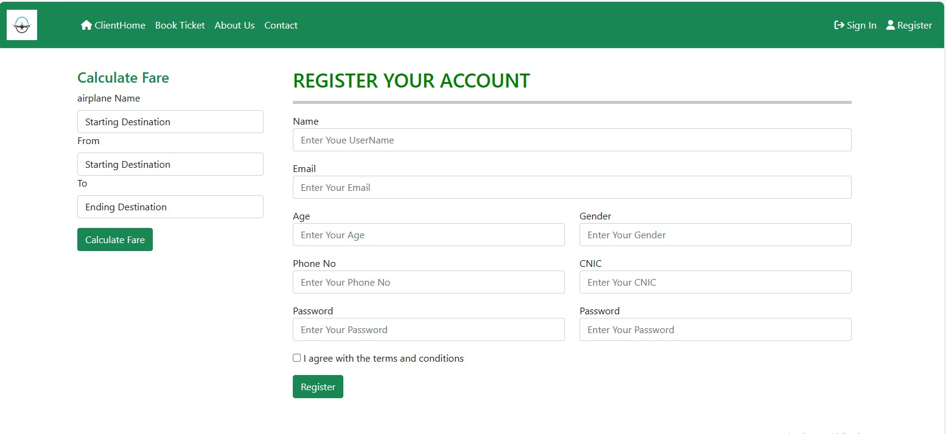
Register page Interface

Slide 23
Thank you

